Slide 1
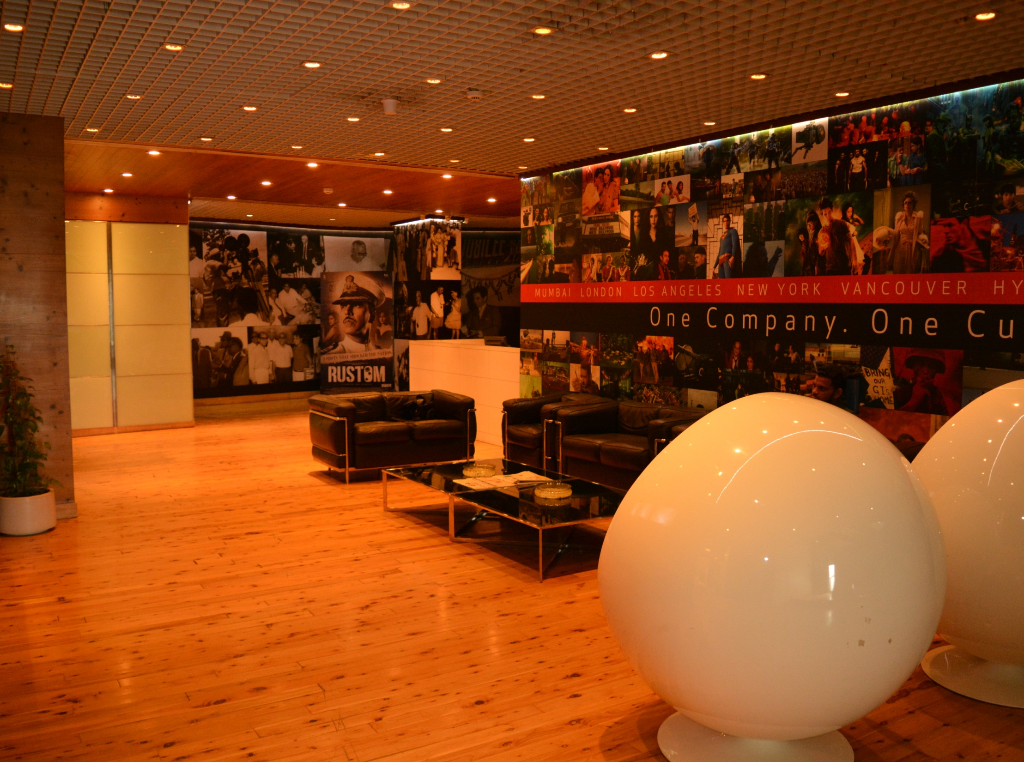


Prime Focus Limited
Corporate Presentation 2018
World’s largest independent integrated media services powerhouse!

Slide 2
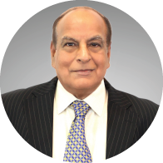
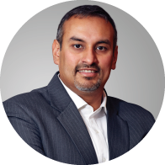
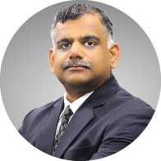
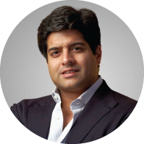
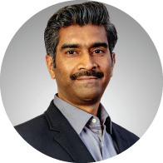
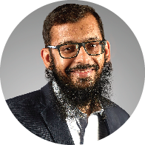
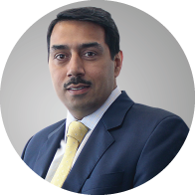
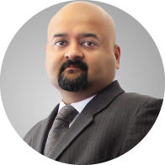
Our Global Leaders
NARESH MALHOTRA
Chairman Emeritus
Prime Focus
NAMIT MALHOTRA
Founder, Executive Chairman
and Global CEO
Prime Focus
RAMKI SANKARANARAYANAN
Founder & CEO,
Prime Focus Technologies
Managing Director, Prime Focus
MERZIN TAVARIA
Chief Creative Director
& Co-founder
Prime Focus
PRAKASH KURUP
Co-founder and
Creative Director (Advertising)
Prime Focus
HUZEFA LOKHANDWALA
Co-founder and
Creative Director (Advertising)
Prime Focus
VIKAS RATHEE
Chief Financial Officer
DNEG
NISHANT FADIA
Chief Financial Officer
Prime Focus
VIKAS RATHEE
Group Chief Financial Officer
Prime Focus

Slide 3






The Prime Focus Journey
2014
PFW works on more than half of all the summer releases of the major Hollywood studios
PFT acquires DAX® (creators of PrimeTime Emmy® award-winning Digital Dailies®) and Academy® Award winning Lowry Digital
PFW and Double Negative merge their Hollywood-facing VFX businesses
PFW secures U.S. Patent for View-D stereo conversion technology
Reliance Capital picks up 30.2% in Prime Focus; Prime Focus merges Film & Media Services business of Reliance MediaWorks
PFT-restored Associated Press Archive Digitization wins FOCAL International Award
2013
Prime Focus raises US$38 MN investment from Macquarie Capital
PFW wins Advanced Imaging Society 3D Award for ‘Gravity’
PFT launches world’s largest digital media services cloud
Prime Focus raises US$10 MN from AID Partners Public Equity
PFT wins Aegis Graham Bell Award 2013 for Innovation in Cloud-based Solutions
2012
Prime Focus Animation launched
Prime Focus raises investment from Standard Chartered Public Equity
PFT digitizes Star TV’s content operations through CLEAR™
PFW delivers 3D Conversion of Star Wars: Episode I for Lucas film / ILM
2011
2010
2009
PFW becomes first company to convert an entire Hollywood film to 3D
PFT’s CLEAR™ Media ERP recognized as ‘Best of IBC’
Prime Focus launches View-D™ and CLEAR™
PFT deploys the World's First Hybrid Cloud Platform
2008
2007
Prime Focus launches new Technology arm – Prime Focus Technologies (PFT)
Entry into US through acquisition of Post Logic and Frantic Films
2006
2004
Entry into UK market via acquisition of AIM Listed company
IPO of Prime Focus Limited on BSE and NSE
First visual effects company in India to operate a motion-control rig
2003
2001
Offered India’s first DI system
Offered India’s first scanning and recording system
1997
Prime Focus Ltd. (PFL) founded by Namit Malhotra in a garage in Mumbai

Slide 4

The Prime Focus Journey
2018
Prime Focus limited enters ‘Fortune India 500’ companies
Advertising division delivered post production services for 4 ABBY award winners
DNEG wins academy award, BAFTA and VES award for Blade Runner:2049
2017
Prime Focus delivers post-production services for 12 national award winning films
Advertising division delivered post-production services for the world’s best advertisement of 2016
2016
Double Negative wins Academy Award and British Independent Film Award for ‘Ex Machina’
Prime Focus wins 'Best VFX' for 'Bhajrangi Bhaijaan' at 24FPS International Awards
PFW's 'DeepGen' Stereo Technology recognised with AIS Lumiere Technology Award
PFT picks up two awards at 2016 CMO Asia Awards, including ‘Marketing Campaign of the Year’
Prime Focus divests 30% stake in Digital Domain-Reliance, LLC; to form Virtual Reality and Advertising JV in India; Total Deal Value at US$ 55 million
Prime Focus Technologies secures investment from Ambit Pragma Private Equity
2015
Double Negative wins Academy Award, BAFTA and VES Award for Interstellar
PFW and Gener8 sign Technology Licensing Partnership
PFT honored with Two MarCom Awards for DIGITAL NEXT Campaign
Prime Focus wins Best VFX Awards for ‘Kick’ (IIFA Awards) and ‘Sin City: A Dame To Kill For’ (Apollo Asia Awards)
PFT honoured with Frost & Sullivan’s 2015 Global Growth Excellence Leadership Award

Slide 5
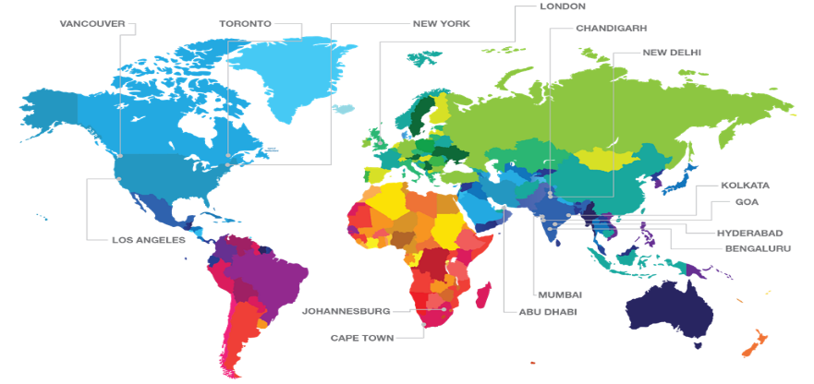
‘World Sourcing’ model = unmatched competitive edge
Global network providing highest quality, fastest time to market & most efficient pricing
India (Mumbai, Kolkata, Noida, Hyderabad, Chandigarh, Bengaluru, Chennai and Goa)
Over 7,000 skilled employees
Approx. 1/5th the cost compared to Western artists
Canada
Over 600 employees for VFX and 3D execution
Differential Tax credit benefits across states and cities
MONTREAL
U.K.
Over 1,000 employees primarily for creative execution
Production rebates
CHENNAI
U.S.
~100 employees for client servicing
Sydney
employees for client servicing (PFT)
SYDNEY
5 continents | 7 time zones | 18 locations | 24/7 – 365 days

Slide 6


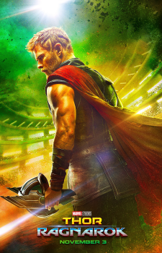

International Creative Services
We are a multiple Academy Award winning International Creative Services company
International Visual Effects
DNEG is our international visual effects, Stereo Conversion and Animation division.
DNEG has won three consecutive Academy Awards for Best VFX – for Interstellar in 2015, Ex Machina in 2016 and Blade Runner 2049 in 2017. The company has a total of four Oscars, having previously won the same award for Inception in 2011
In 2017 DNEG delivered an unprecedented number of major VFX projects, including the highest grossing film of the year at the international box office – The fate of the Furious
Other recent noteworthy projects include Dunkirk, Blade Runner 2049, Thor Ragnarok and Justice League.

Slide 7



International Awards
Academy Award®
Winner: Best Visual Effects for ‘Blade Runner 2049’ (2017)
Winner: Best Visual Effects for 'Ex Machina' (2015)
Winner: Best Visual Effects for 'Interstellar' (2014)
Winner: Best Visual Effects for 'Inception' (2010)
BAFTA
//
Winner: Special Visual & Graphic Effects ‘Black Mirror – Season 4’ (2018)
Winner: Best Special Visual Effects for ‘Blade Runner 2049’ (2017)
Winner: Best Special Visual Effects for ‘Interstellar’ (2014)
Winner: Best Special Visual Effects for ‘Harry Potter and the Deathly Hallows Part 2’ (2011)
Winner: Best Special Visual Effects for ‘Inception’ (2010)
Advanced Imaging Society
Winner: Best 3D Scene of the Year ‘Beauty and the Beast’ (2017)
Winner: Technology Award – DeepGen: Deep Compositing in Stereo (2015)
Winner: Best Stereography: Live Action for ‘Sin City: A Dame To Kill For’ (2015)
Winner: Technology Award – Hybrid Stereo Pipeline (2014)
Winner: Outstanding Use of 2D to 3D Conversion for ‘Gravity’ (2014)

Slide 8
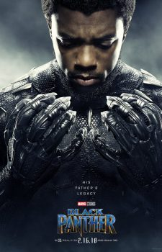
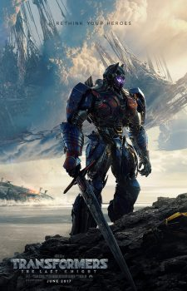
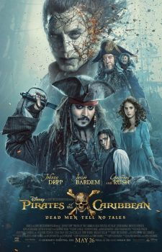

International Creative Services
International Stereo 3D Conversion
From early 3D work on Avatar to milestone 3D movies such as Harry Potter and the Deathly Hallows Parts 1 & 2, Gravity, Avengers: Age of Ultron and more recently Pacific Rim, Prime Focus has been behind the 3D versions of over 50 major Hollywood films
Recent work includes some of the biggest global releases, including Black Panther, Transformers, Pirates of the Caribbean and Beauty and the Beast.

Slide 9
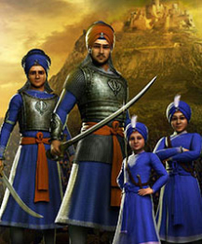

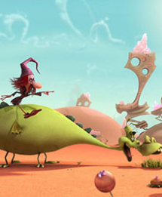

International Creative Services
International Animation Services
Set up in 2014, DNEG’s Feature Animation division works in tandem with IP creators and filmmakers to create high-end animated features, based out of DNEG’s London HQ.
The team is led by Tom Jacomb, who has many years of experience as Associate Producer and Line Producer on full CG Animated Feature Films, having previously built two feature animation studios in London and Vancouver.
Our recently completed projects include Chaar Sahibzaade – The Rise of Banda Singh Bahadur, the 120 min animated sequel to India’s most successful Punjabi film ever
The animation team is currently in production on animated feature Here Comes The Grump, a co-production with South America’s Anima Estudios, amongst many other ongoing projects

Slide 10
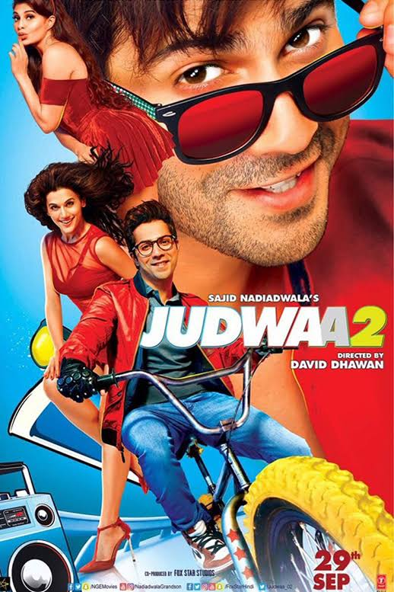
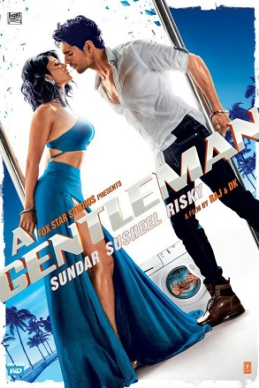
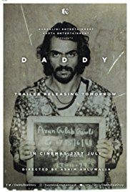
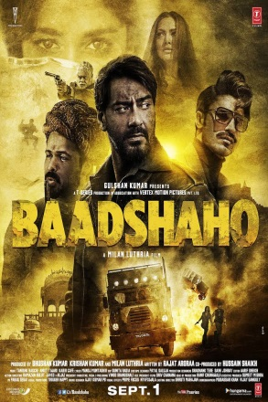
Post Production Services for Film, TV & Advertising
We are the leading Post Production provider to the Indian Film, TV and Advertising industries
Visual Effects
Prime Focus has long been a force to be reckoned with in the Indian Film Industry, delivering the highest-quality visual effects services to the country’s biggest releases
Last year alone, we delivered over 10,500 VFX shots on over 52 feature film projects, including Judwaa 2, A Gentlemen, Daddy & Badshaho

Slide 11
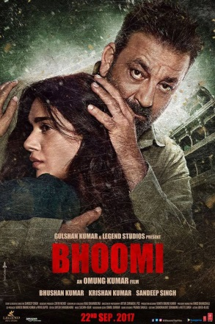
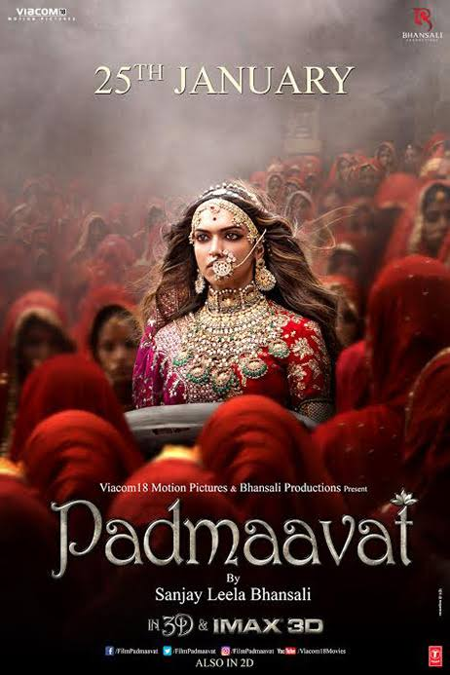
Post Production Services for Film, TV & Advertising
Digital Intermediate
We were also the first company to introduce Digital Intermediate technology in India, and have now provided colour grading services on over 500 feature films
Stand-out DI projects of 2017 include Judwaa 2, Bhoomi, Padmaavat and Bhadshaho

Slide 12
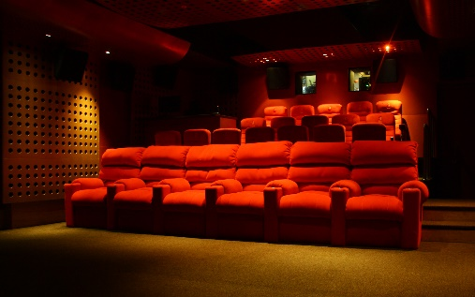
Prime Focus, Royal Palms, Goregaon East, Mumbai
Film Post
Market leader in film post
VFX
DI – Baselight and Lustre
Dolby 5.1 sound mix studio
Largest production equipment rental in Asia
  Arri Alexa
  Sony F65
  Red digital camera
30 & 75 seat preview theaters

Slide 13






Bollywood Awards
Best Visual Effects (2008)
Best Visual Effects (2009, 2006)
Best Visual Effects (2006)
Best Visual Effects Feature Film (2012,13,14,15, 16)
Best VFX Shot of the year (2006,07,08,10)

Slide 14
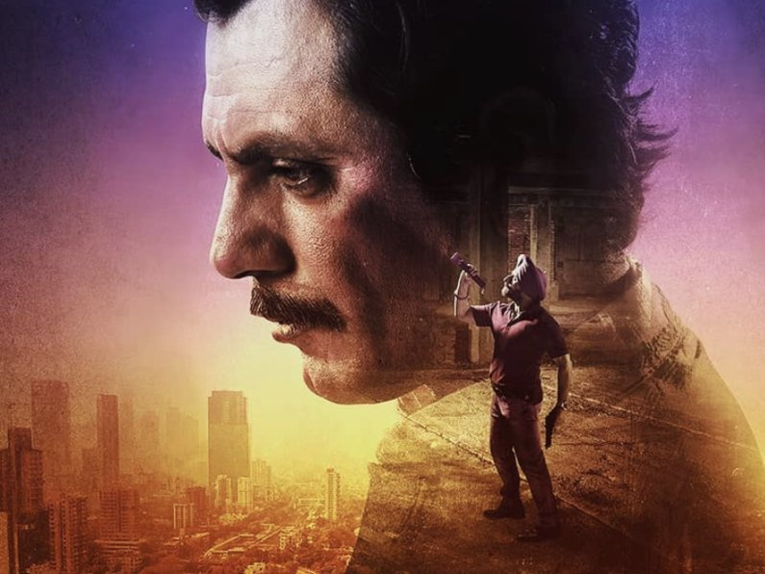
Web Series & TV Projects
Prime Focus recently delivered all 8 episodes of Netflix’s ‘Sacred Games’
Upcoming web series include ‘The Forgotten Army’ for Amazon Prime Video and another for Times Network.
Prime Focus’TV projects include Satyamev Jayate, 24, Nat Geo Mission Cover Shot and Master Chef India.

Slide 15
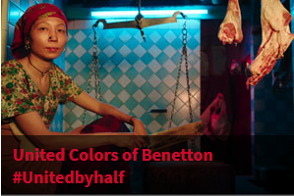
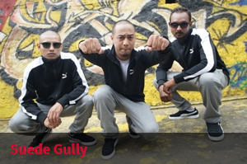
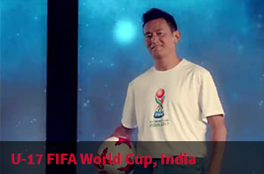
Post Production Services for Film, TV & Advertising
Advertising Post Production
The Advertising Services offers a series of high-profile hires across our creative team and a new offline editing facility.
Our newly revamped offering delivers the Indian Advertising community world-class post production technology and access to some of the nation’s leading creative talent
In 2017 we recorded 60% growth on the number of ads we finished, delivering 1200 commercials over the 12 month period

Slide 16
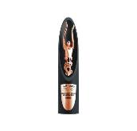
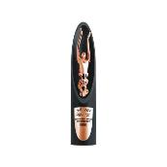


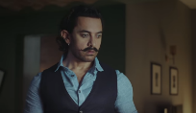

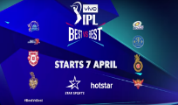
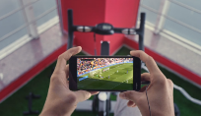
Delivering top Indian TV Commercials
  TV Commercials for the quarter
  4 ABBY Awards during FY18
Flipkart
Honda
GOLD
SILVER
Vivo
Swiggy
Kaveri
https://www.youtube.com/watch?v=KAvtWcj1kuM
MTV Beats
https://www.youtube.com/watch?v=LA0YXaZ2o8o
BRONZE
BRONZE
IPL Anthem
Nokia
ISL- ATK
https://www.youtube.com/watch?v=ssx95sKx_VU
Perfect Short FIlm
https://www.youtube.com/watch?v=ck0IjzlWabw

Slide 17
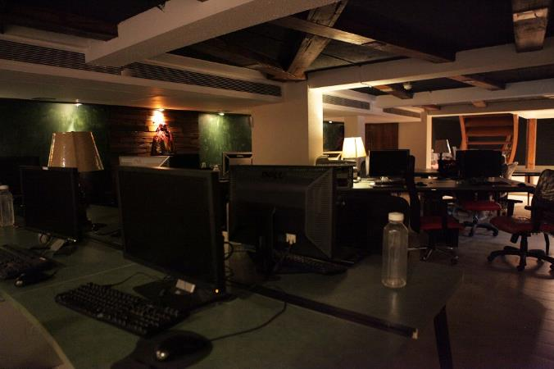
Prime Focus, Khar West, Mumbai
Advertising Post
10,000 sq. ft.
State-of-the-art HD post facility dedicated to advertising industry
12 Smoke/Flame edit suites
50 seats for VFX
Baselight color grading suites and Telecine

Slide 18


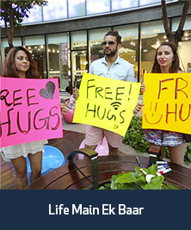
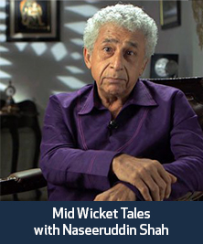
Post Production Services for Film, TV & Advertising
Broadcast Post Production
Prime Focus is a dominant player in the Indian Broadcast segment
With the advent of HDTVs and high-def broadcast channels, broadcasters are looking for higher-quality post production solutions
Prime Focus is leading the way with work on high-profile Indian TV shows such as MTV Roadies, M Bole Toh, Life Main Ek Baar, Mid Wicket Tales with Naseeruddin Shah and Back to Flashback with Jaaved Jaaferi

Slide 19

Camera and Shoot-kit Equipment Rental Services
We operate India’s largest camera and shoot-kit equipment rental service
EQR Equipment Rental
Prime Focus EQR Equipment Rental Service has an impressive inventory of over 40 high-end feature film cameras and has established itself as the undisputed market leader in the industry
The team at EQR comprises experienced shooters and creative & technical industry professionals, and clients have come to rely on the team for expert technical support
The division has a large client base ranging from independent filmmakers to large studios, and also caters to the advertising market
We provided cameras to 65 productions in 2017, including films such as Tubelight, Judwaa 2, Bhoomi and Badshaho

Slide 20
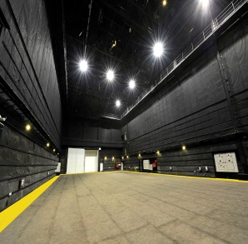
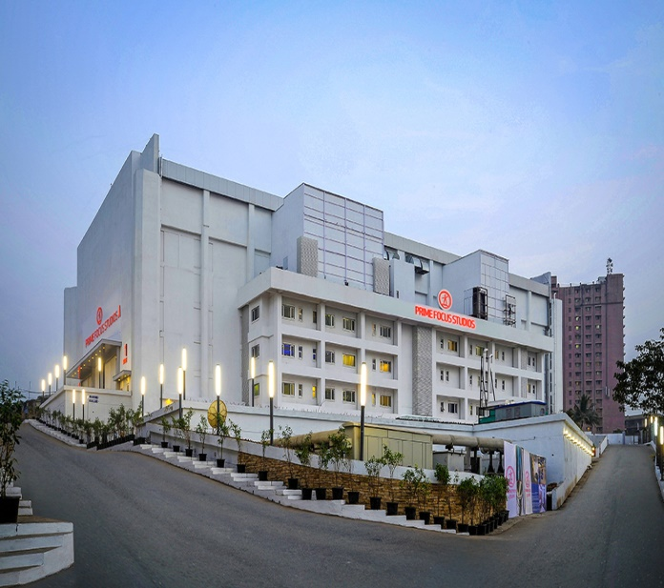
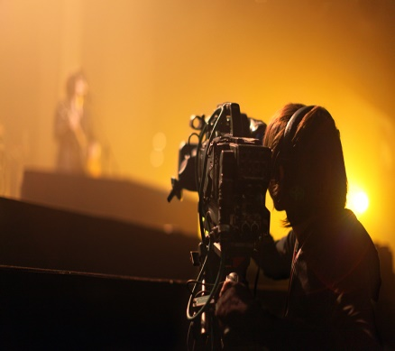
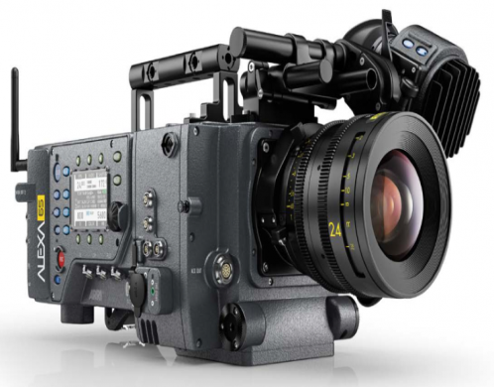
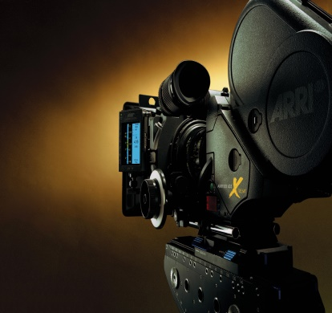
India’s largest integrated studio facility
SHOOTING FLOORS
One of the largest camera
service providers in India

Slide 21
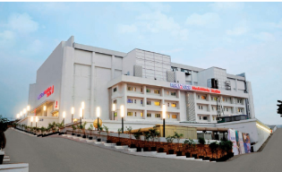
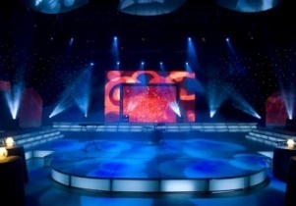
Prime Focus Studios, Film City, Goregaon East, Mumbai
India’s largest integrated Studio facility
MPAA, Fox Security Group (FSG) accredited facilities –
  200,000 sq. ft. state-of-the-art Studio facility in Film City – India’s largest
  8 Hollywood benchmarked sound stages
  90,000 sq. ft. SEZ in Navi Mumbai and 75,000 sq. ft. facility in Film City
Film Processing Lab
Film image enhancement
Only DI Lab with 4K facility in South Asia
Sound stages & shooting floors

Slide 22
Prime Focus Academy for Media & Entertainment Studies (PFAMES)
We offer specialized courses in creative services through our certified faculty, preparing students for a career in the media & entertainment services sector
PFAMES
PFAMES is a certified faculty offering students a well-designed curriculum that prepares them for the real world
The courses are certified by the Media and Entertainment Skills Council (MESC), opening up a host of career opportunities in the global M&E services market
The courses are designed by recognized industry experts to make students ‘industry-ready’, fully conversant with the latest hardware and software tools
Our mission is to create and grow a sustainable talent pool of creative graduates to meet the overwhelming demand for professionally trained artists in our industry, thereby helping to position India as a leader in the global media and entertainment services sector
Our vision is that our customized training programmes should be available to anyone with a flair for learning, whether creatively inclined or not, helping our students to become productive, positive-thinking, well-trained professionals in an expanding market with international opportunities.

Slide 23
















Technology Services: Pioneer & leader in cloud solutions for M&E industry
Unique & Comprehensive PRODUCT + SERVICES approach
Products
Services
CLEARTM Media ERP
Cloud MAM
Broadcast Cloud
DAX® Production Cloud
Operations Cloud
Digital Lab
Digital Media Services
Metadata Services
Digitization & QC
Content Re-Mastering
OTT Packaging & Delivery
Compliance & Live Services
Content Localization
Subtitling
Closed Captioning
Dubbing
Audio Description
Re-timecoding of Subtitle/CC File
Creative Services
Promo Services
Post Production
Brands Services
Marquee Clients
Broadcasters
Studios
Content
Creation
Content
Transformation
Content
Distribution
Content
Exhibition
Brands
Service Providers

Slide 24




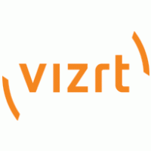






CLEAR™ Media ERP – One Software for the entire M&E Enterprise
Production
Create
Transform
Distribute
Opportunity to be Oracle & SAP for M&E Industry
Broadcast
Marketing
Across Supply Chain
Creation
Applications
Enterprise
Marketing
Across Enterprise
Transform
Legal
Workflow Management
Across Content Lifecycle
Content Management
Distribution
Creative
Delivery
Across Locations & Devices
Processing
Web/ Mobile
STBs
Hybrid Cloud
The Enterprise Application Domain has been consolidated with few Mega-suite Providers
The same evolution is panning out in Media and Entertainment Enterprises
CLEAR™ is the most established Hybrid Cloud Media ERP across the globe

